Slide 1
8257/8237 DMA Controller
P.RAJESH M.Tech.,
Asst Professor
CRIT engg college

Slide 2
DIRECT MEMORY ACCESS
DMA method is fastest among all data transfers methods.
The device may transfer the data to or from the memory with out interference of processor.
In DMA method of data transfer the device requests processor to hold its address bus, data bus and control bus , so it can directly transfer the data to or memory with out interference of processor .
Data transfer is initialized after receiving acknowledgment from processor.

Slide 3
ARCHITECTURE
It is a 4-channel (ch0-ch3) DMA.
So 4 I/O devices can be interfaced to DMA
It is designed by Intel
Each channel have 16-bit address and 14 bit counter
provides chip priority resolver that resolves mode.
2-modes:- 1) normal priority 2) rotating priority

Slide 4
Data bus buffer :- is 8-bit ,hi state , bidirectional bus.
Read write logic :- used to provide necessary RD & WR
Control mode set logic:- provides necessary control signals to DMA controller.

Slide 5
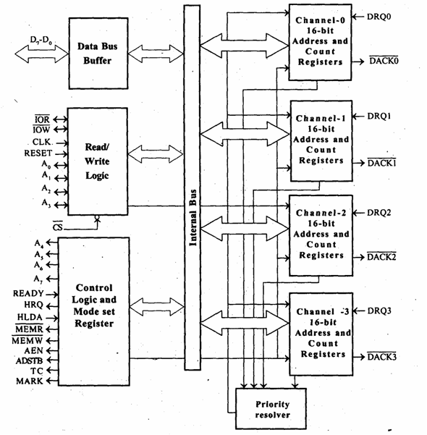
Block Diagram

Slide 6
Register organization of DMA controller.
Each DMA channel consists of “2”→ 16 bit reg
A) DMA address reg
B) terminal count reg
Due to that totally “8”→ 16 bit reg along with this 2 more “8-bit” reg which are common for all the channels
A) mode set reg
B) status reg

Slide 7
A) DMA address reg
The function of DMA reg is to store the address of starting memory location from which they are transferring the data .
It is a 16-bit reg among the 16-bit lower order 14-bits are (D0-D13) used to represent a terminal count. the remaining 2 bits are used to respect the type of DMA operation.
B) TERMINAL COUNT REG

Slide 8
A) mode set reg
Mode set reg is used to program the 8257.
The function of DMA is to enable DMA channels individually and set various mode of operations.
The DMA channels should not be enabled un till DMA address reg & terminal count reg contain valid information. Other wise destorys valid memory data.

Slide 9
Bit 15 | Bit 14 | Type of DMA operation
0 | 0 | VERIFY DMA CYCLE
0 | 1 | WRITE DMA CYCLE
1 | 0 | READ DMA CYCLE
1 | 1 | NO DMA OPERATION
A10-A15 DMA starting address , C0-C13 terminal count values (N-1)
Rd & Wr DMA verify (00),write (01) or read (10) cycle selection, AL-auto load ,TCS-terminal count start,TC Stop, EW- extended write ,RP-rotating priority , EN3-EN0 channel maskable ,UP-update flag , Tc3-Tc0- terminal count status bits.

Slide 10
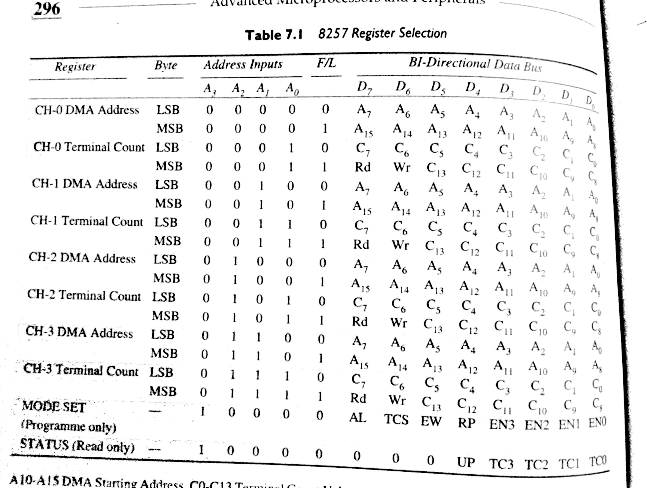

Slide 11
The bits D0-D3 enables one of the four DMA channels of 8257.
Eg:-
If D0 is 1 then channel- 0 is enabled.
If D4 id set rotating priority is enabled, other wise normal. i.e fixed priority is enabled.

Slide 12
D7 | D6 | D5 | D4 | D3 | D2 | D1 | D0
if 1
if 1
Enables auto load
Enables Channel 0
Enables TC stop
Enables Channel 1
Enables Channel 2
Enables extended Write
Enables Channel 3
Enables rotating priority

Slide 13
Status register
D7 | D6 | D5 | D4 | D3 | D2 | D1 | D0
if 1
TC status Channel 0
TC status Channel 1
TC status Channel 2
TC status Channel 3
Update flag

Slide 14
In this lower order 4 bits contain terminal count status for 4 individual channel.
If any one of this is set , it indicates specific channels has reached the terminal count condition. These bits remains set till either the status is read by CPU(or)8257 is reset.
Update flag is not affected by read operation

Slide 15
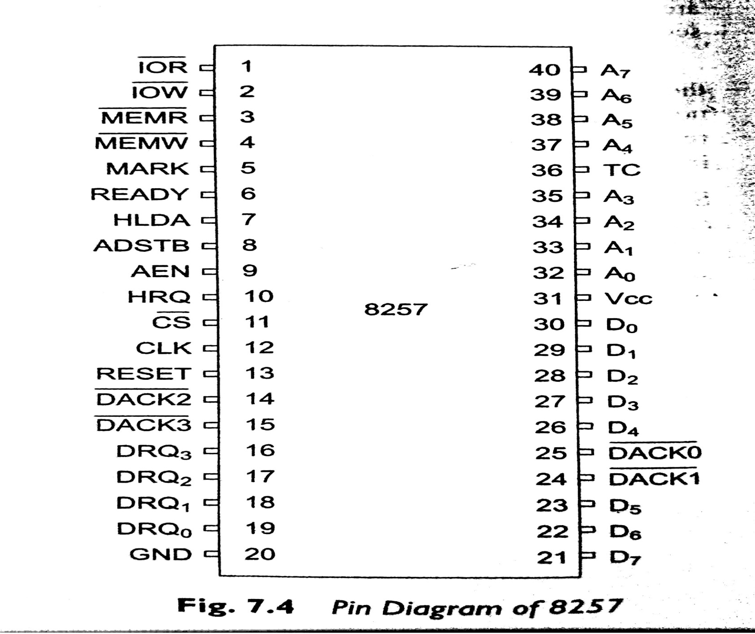
Pin diagram of 8257

Slide 16
D0-D7:
it is a bidirectional ,tri state ,Buffered ,Multiplexed data (D0-D7)and (A8-A15).
These lines carry comand word to 8257 and status word to 8257.
2-modes
i) slave mode & ii) master mode
Slave mode : data is under the control of CPU data over these lines may transfer in both direction
Master mode : data is not under control of CPU.
IOR:
It is active low ,tristate ,buffered ,Bidirectional lines.
Acts as slave mode that input signal is used by CPU to read internal register .
In out signal it is master mode used to read data from peripheral during memory write cycle.

Slide 17
IOW:
It is active low ,tristate ,buffered ,Bidirectional control lines.
As in input slave mode to load content of data bus to the 8-bit mode register (or) lower /upper byte of 16-bit DMA address reg or terminal count reg.
As in master mode output signal loads data to peripheral during DMA memory read cycle ( writes to peripherals).
CLK:
It is the input line ,connected with TTL clock generator
RESET:
Used to clear mode set registers and status registers
A0-A3:
A0-A3 are 4 least significant bits address lines of memory address on the lines.

Slide 18
CS : is an active low chip select lines enables read/write operation.
READY:
It is a asynchronous input line used to stretch memory read & writes cycles.
In master mode, when ready is high it is received the signal.
HRQ:
It is used to receiving the hold request signal from the output device.
HLDA:
It is acknowledgment signal from microprocessor.

Slide 19
AEN (Address enable):
It is a control output line.
Used it isolate the system address ,data ,and control lines.
ADSTB: (Address Strobe)
It is a control output line.
Used to split data and address line.
TC (Terminal Count):
It is a status of output line.
It is high ,it selected the peripheral.
It is low ,it free and looking for a new peripheral.
MARK:
It is a modulo 128 MARK output line.

Slide 20
DRQ0-DRQ3(DMA Request):
These are the asynchronous peripheral request input signal.
The request signals is generated by external peripheral device.
DACK0-DACK3:
These are the active low DMA acknowledge output lines.
Low level indicate that ,peripheral is selected for giving the information (DMA cycle).
In master mode it is used for chip select.
Control logic block:
It contains ,
Control logic
Mode set register and
Status Register.

